Slide 1




Shrink Forecasting Using Deep Learning Methodologies
June 8th, Final Update
Renpin Luo https://www.linkedin.com/in/renpin-luo-a770241b7/
Milan McGraw https://www.linkedin.com/in/milan-mcgraw/
Krish Seth https://www.linkedin.com/in/krishseth/

Slide 2
Agenda:
Problem - Opportunity
Approach
Feature Importance
Economic Indicators
Models:
LSTM
DeepAR - Store Level
LSTNet
Prophet - (700 Stores)
Model Results
Future Improvements~

Slide 3
Problem - Opportunity
$1.8B
Notes:
Home Depot relies on a modeling framework that predicts shrink on an ongoing basis using the most current data. However, this leaves stores without knowledge of what may happen between today and the 3, 6, or 9 months leading up to the inventory. $1.8B
HD measures shrink at the yearly level, which makes it challenging to create a modeling framework that accurately predicts out shrink, so the complexity of forecasting using alternative methodologies to predict out shrink at the weekly level challenging.
So by exploring other modeling methods to anticipate future trends, it will be possible to understand how past data trends will translate into total shrink at the end of an inventory.

Slide 4
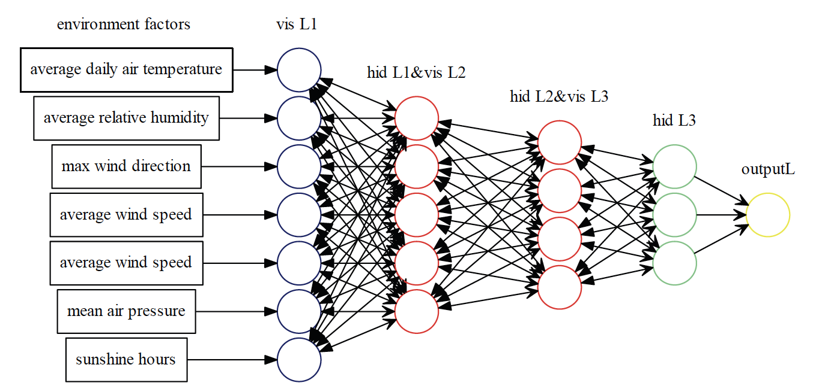
Approach
Identify the most important variables to forecast
Solve Time Series Problem utilizing deep learning
Forecast out by week 13-26 weeks out (potentially 39-52 weeks)
Shrink Factors
Economic Indicators
Shrink Rate
FET, LU, Location
HR, Terms, Tenure
Competition
CS/RNN/BOPIS
Clearance, Turns
Notes:
Average Tenure, Quick Term, Average Wage, PT Ratio,
Identify the most important variables to forecast, which allows us to create powerful forecast engine, presents a vast and highly complex problem that an AI/deeplearning model can help to answer.

Slide 5
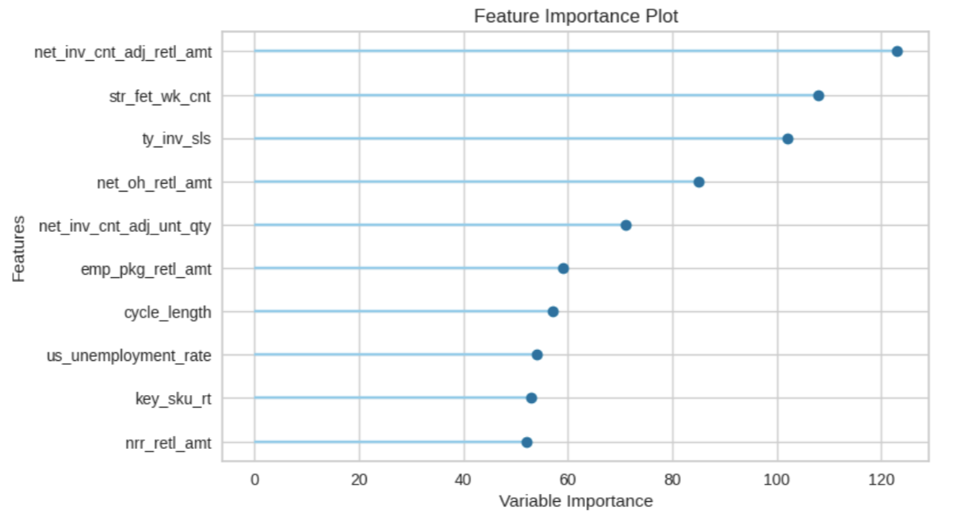
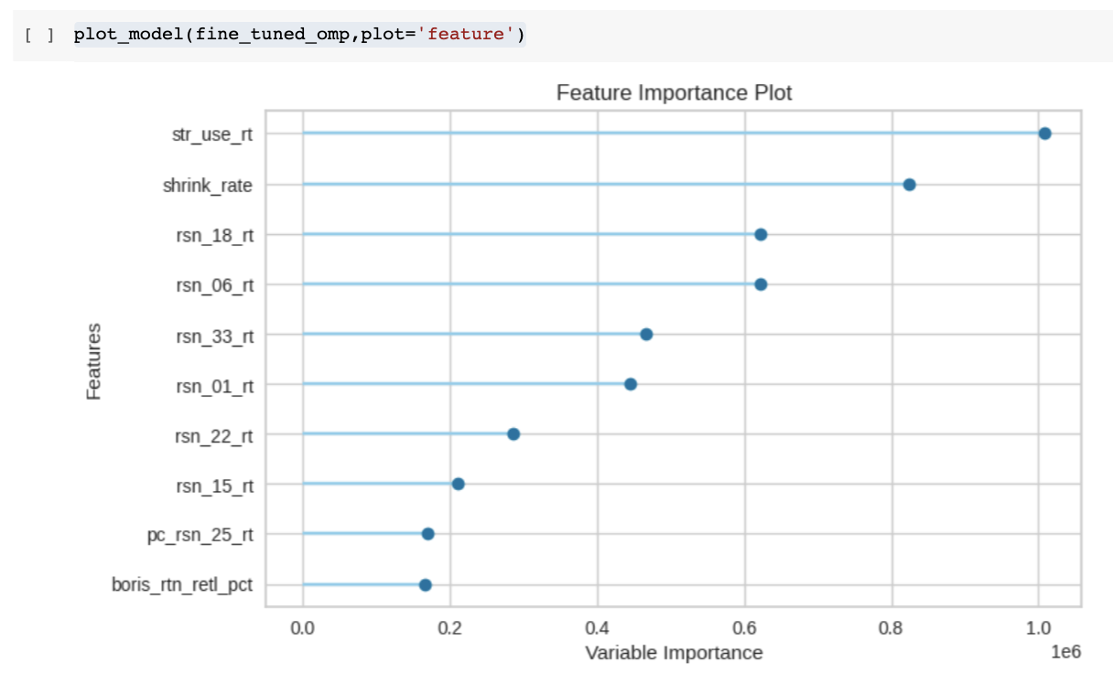
Feature Importance:
Notes:
Milan
Feature Importance is a process used to select features in the data that contributes the most in predicting the target variable. Working with selected features instead of all the features reduces the risk of over-fitting, improves accuracy, and decreases the training time. We used PyCaret, which utilizes combination of several supervised feature selection techniques to select the subset of features that are most important for modeling. Those features with minimal variance were removed.
Orthogonal Matching Pursuit Algorithm I OMP is I an iterative algorithm : it finds x element-by-element in a step-by-step iterative manner. I a greedy algorithm: at each stage, the problem is solved optimally.
https://www.di.ens.fr/~mallat/papiers/MallatPursuit93.pdf
A greedy algorithm that chooses at each iteration a wave form that best adapted approximate the signal.

Slide 6
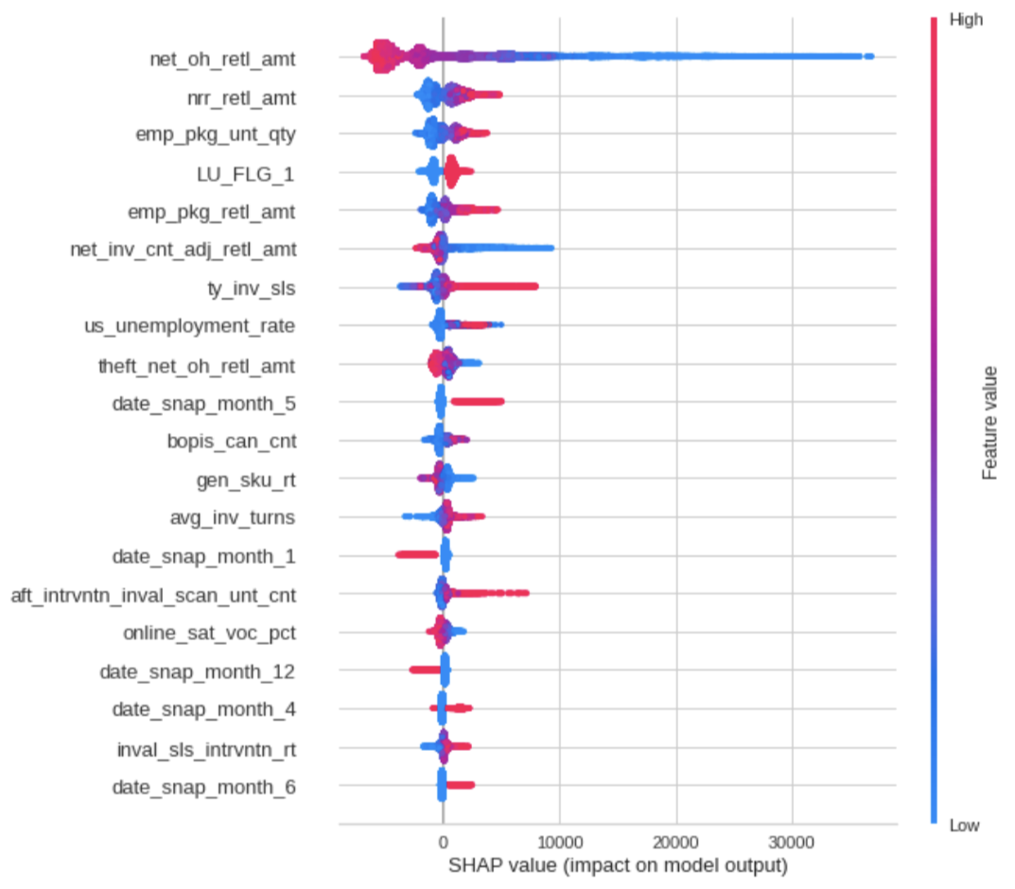
Feature Importance: SHapley Additive exPlanations
Notes:
Milan -
What SHAP does is quantifying the contribution that each feature brings to the prediction made by the model.
The “game” is reproducing the outcome of the model.
The “players” are the features included in the model.
Global interpretability — values can show how much each predictor contributes, either positively or negatively, to the target variable. This is like the variable importance plot, but it is able to show the positive or negative relationship for each variable with the target.
Local interpretability — each observation gets its own set of SHAP values (see the individual SHAP value plot below). This greatly increases its transparency. We can explain why a case receives its prediction and the contributions of the predictors. Traditional variable importance algorithms only show the results across the entire population but not on each individual case. The local interpretability enables us to pinpoint and contrast the impacts of the factors.

Slide 7
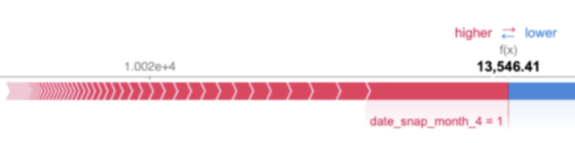
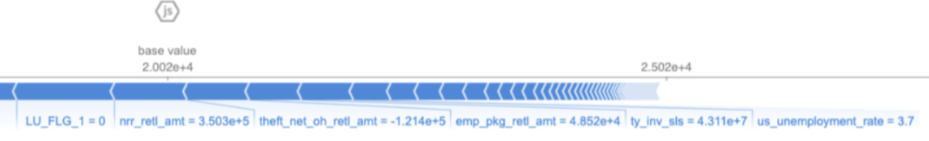
Feature Importance: SHapley Additive exPlanations
Notes:
Milan -
The “game” is reproducing the outcome of the model,
What Shapley does is quantifying the contribution that each player brings to the game.
Local interpretability — each observation gets its own set of SHAP values (see the individual SHAP value plot below). This greatly increases its transparency. We can explain why a case receives its prediction and the contributions of the predictors. Traditional variable importance algorithms only show the results across the entire population but not on each individual case. The local interpretability enables us to pinpoint and contrast the impacts of the factors.

Slide 8
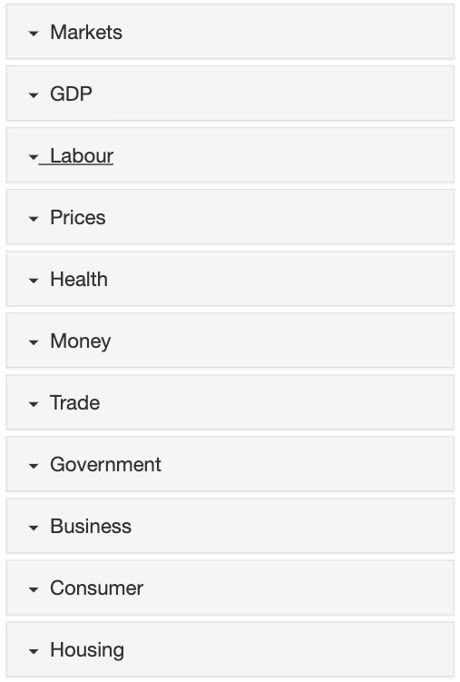
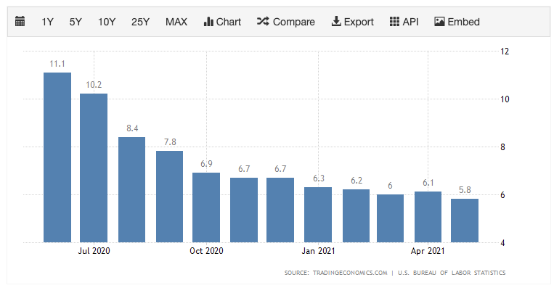
Economic Indicators
Unemployment Rate by State
Youth unemployment 14-24 year olds
Notes:
Milan -
Why are Economic Indicators important?
To understand the reasons to use economic indicators, we must first comprehend what they are. An economic indicator is a statistical representation of an economic activity.
Economic Indicators allow us to analyze economic performance and make predictions of how it is going to perform in the future.

Slide 9
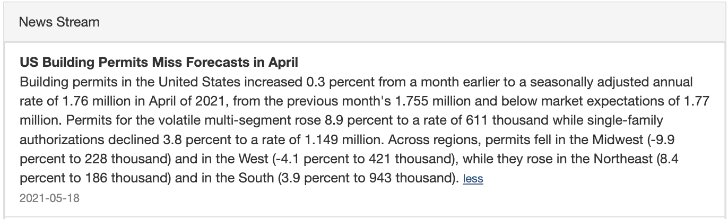
Economic Indicators:
US Building Permits by Local Zip
Local Mortgage Applications
Interest Rates
Gasoline Prices
Notes:
Milan - https://tradingeconomics.com/united-states/unemployment-rate
Economic Indicators important?
because they are a key input when making important business decisions, forecasts or policy, research in a wide variety of disciplines and more.
Changing market conditions make it necessary for Home Depot to have access to reliable information in order to make intelligent decisions.

Slide 10
Agenda:
Models:
LSTM
DeepAR - Store Level
LSTNet
Prophet - (700 Stores)
Live Walkthrough
Model Results
Future Improvements~

Slide 11
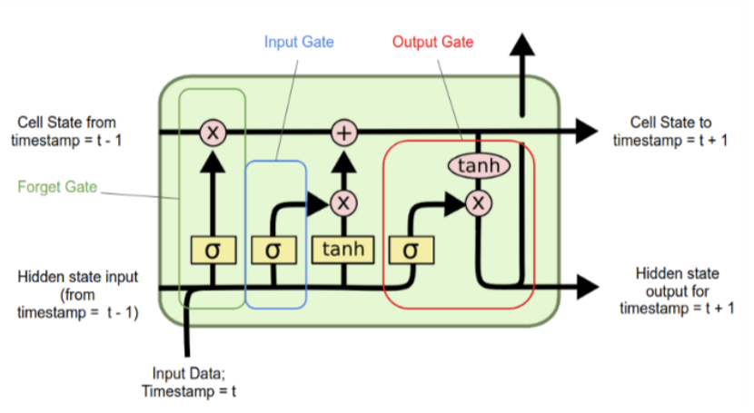
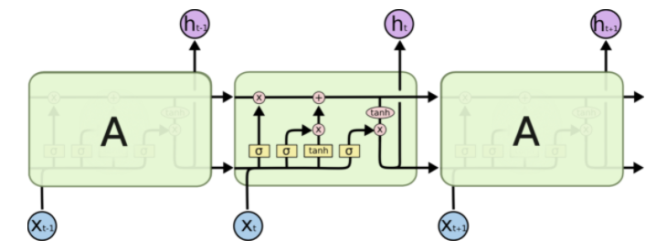
LSTM - Long Short-Term Memory (LSTM)
Notes:
Milan
https://colah.github.io/posts/2015-08-Understanding-LSTMs/
The key to LSTMs is the cell state, the horizontal line running through the top of the diagram.
The cell state is kind of like a conveyor belt. It runs straight down the entire chain, with only some minor linear interactions. It’s very easy for information to just flow along it unchanged.
Step 1 - Forget Gate - The first step in our LSTM is to decide what information we’re going to throw away from the cell state. This decision is made by a sigmoid layer called the “forget gate layer.”
Step 2 - Input Gate - The next step is to decide what new information we’re going to store in the cell state. This has two parts. First, a sigmoid layer called the “input gate layer” decides which values we’ll update. Next, a tanh layer creates a vector of new candidate values, C~t. C~t, that could be added to the state. In the next step, we’ll combine these two to create an update to the state.
Step 3 - Output Gate - Finally, we need to decide what we’re going to output. This output will be based on our cell state, but will be a filtered version. First, we run a sigmoid layer which decides what parts of the cell state we’re going to output. Then, we put the cell state through tanh tanh (to push the values to be between −1 and 1 ) and multiply it by the output of the sigmoid gate, so that we only output the parts we decided to.

Slide 12
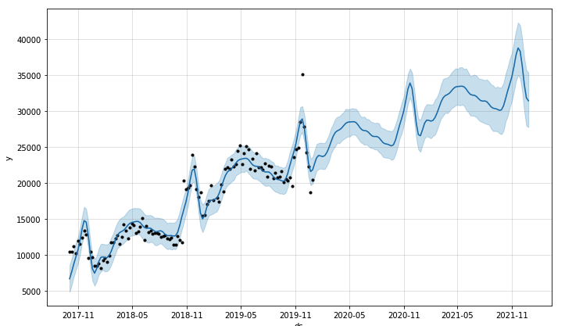
Prophet - Additive Regression Model
Notes:
Krish / Renpin
-used to baseline and see if deeplearning will improve on basic regression forecasting

Slide 13
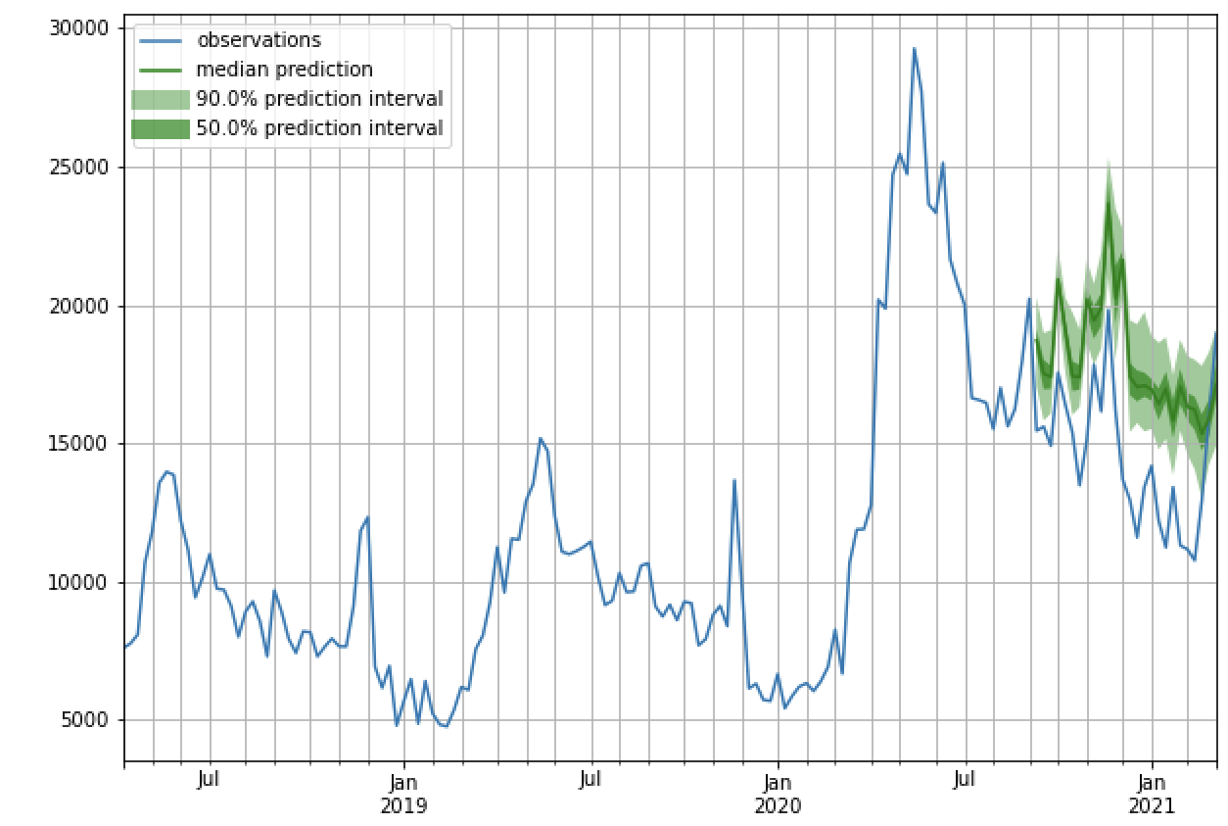
DeepAR GluonTS - Probabilistic Time Series
Notes:
Krish
Here is an example of what one of the 26 week forecasts looks like using DeepAR

Slide 14
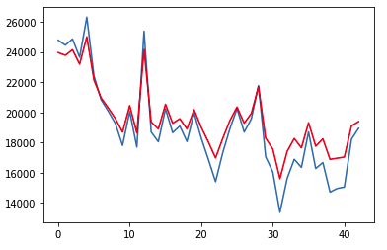
LSTM - Long Short-Term Memory (LSTM)
Notes:
Renpin
250 LSTM layers
epochs=250, batch_size=85
Dropout(0.2)

Slide 15
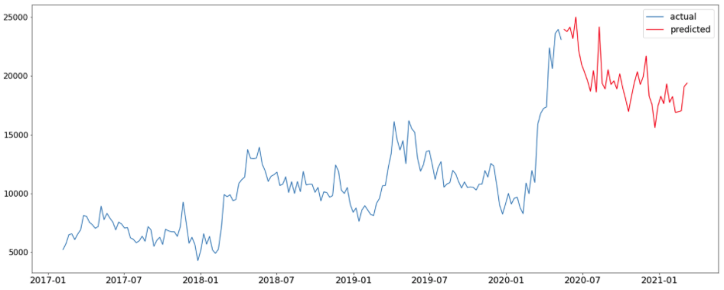
LSTM - Long Short-Term Memory (LSTM)
Notes:
Renpin

Slide 16
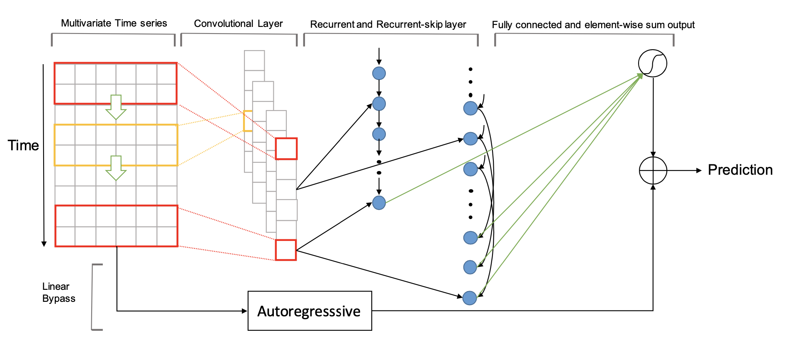
LSTNet - Long and Short term Time-series Network
Notes:
Renpin

Slide 17
Model Walk through...
Lets see live walkthrough….
Notes:
Krish / Renpin
Krish - *show walkthrough of gluon training loop, make sure to explain variable batch size*
Renpin - LSTNet walk

Slide 18
Model Results:
Model Type | Time Frame | MAE | MAPE | RMSE
DeepAR | 13 Weeks | $2,721.67 | 0.0679 | $2,984.21
LSTNet | 13 Weeks | $1,195.26 | 0.0973 | $1,569.58
DeepAR | 26 Weeks | $3,385.22 | 0.1313 | $3,655.26
LSTNet | 26 Weeks | $1,264.33 | 0.1000 | $1,608.17
Prophet | 26 Weeks
DeepAR | 39 Weeks | $5,005.31 | 0.1727 | $5,290.23
LSTNet | 39 Weeks | $1,238.83 | 0.0922 | $1,567.16
DeepAR | 52 Weeks | $18,784.97 | 0.4806 | $21,406.35
LSTNet | 52 Weeks | $1,348.93 | 0.1007 | $1771.20
Notes:
Krish / Renpin

Slide 19
Future Improvements:
State level research
Identify the most important variables to forecast
Additional study on feature importance grouped by store volume, type
Economic Indicators (US, State and Zip)
US employment and Unemployment Rates by State
Youth unemployment rates
Consumer confidence, price inflation, housing data
Scorecard all BOPIS, BOSS, BODFS, BORIS, BOSS by store volume
Potentially increasing inventory frequency or quarterly cycle counts
Data improvements - matrix challenges(different data size for stores with additional inventories) 52 weeks of data vs 104 weeks+
1-4 years of data is sufficient, having 6-8 years of data improves accuracy at predicting 52 weeks out
More dedication to improving hyperparameters to improve predictions
Notes:
Krish / Renpin / Milan

Slide 20
Appendix:
Research Papers:
LSTNet(Long- and Short-term Time-series network):
https://arxiv.org/pdf/1703.07015.pdf
GLUON(Gluon Time Series):
https://gluon-ts.s3-accelerate.dualstack.amazonaws.com/master/index.html
Facebook’s Profit:
https://peerj.com/preprints/3190/

Slide 21
Update
DATA
Stores Dropping
1103, 1573, 1585, 1654, 1657, 1658, 1703, 1790, 1908, 1951, 1990, 2123, 2145, 2503, 2558, 2617, 2657, 2672, 2686 Roughly ~ 912 rows of data
EDA
Shrink Over time vs Region (look at regional differences at Store level)
Weekly Sales vs Region
Shrink Rate Over Time
Sales vs Shrink Rate (defacto status quo)
Sales vs Shrink $
Feature Importance
Condensing RSN columns (open to trial, given low values)
BOPIS (Cancelled %, drop counts)
Economic Indicators
Unemployment
Building Permits
Modeling
LSTNet
Multivariate Time Series - CNN - RNN - FCN
RNN
CNN - LSTM
First Output - Tuesday June 1st

Slide 22
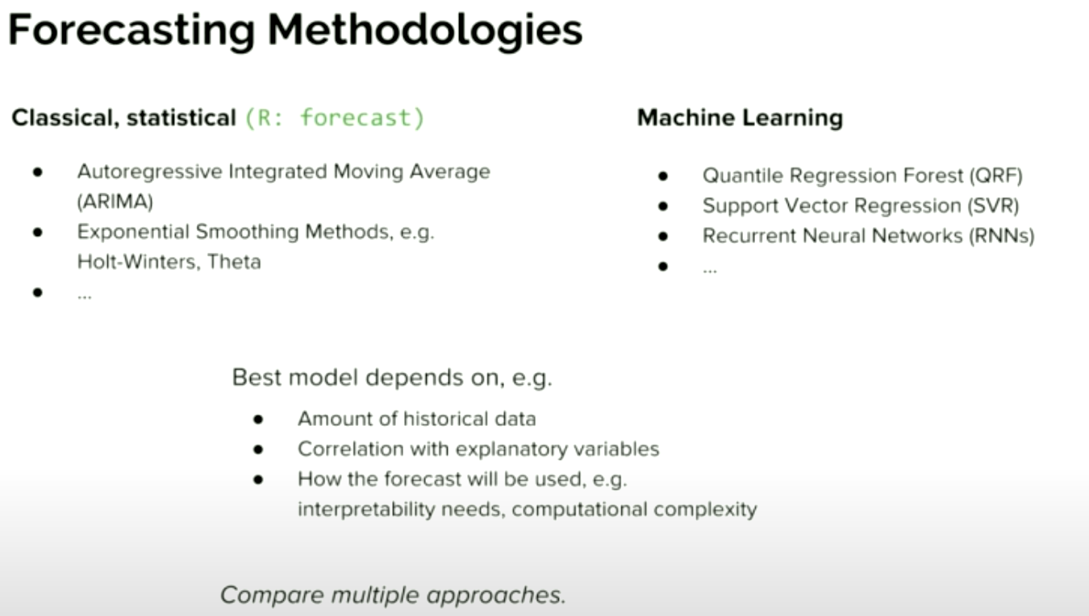
Appendix:

Slide 23
June 1st Progress
Prophet - additive regression model
Evaluation Metric r^2
A piecewise linear or logistic growth curve trend. Prophet automatically detects changes in trends by selecting changepoints from the data.
A weekly component using dummies, yearly seasonal component modeled using Fourier series.
LSTM - Long Short-Term Memory (LSTM)
Evaluation Metric r^2
Gates learns which data in a sequence is important to keep or throw away.
DeepAR GluonTS - Probabilistic Time Series Modeling
Evaluation Metric r^2: currently at 0.95
RNN based global model
Economic Indicators
US Unemployment Rate
US Unemployment Rate: 16 - 24 year olds
Not Added: Building Permits, Inflation, Crime
In progress feature importance:
Currently have inclusive results

